Slide 1
Ms. Figueroa
Pre-K Class

Slide 3
September Snack Schedule

Slide 4
Class Schedule
7:45-8:15 Table Centers
8:15-8:40 Morning Meeting
8:45-9:00 Itchy’s Alphabet
9:00-9:15 Recess
9:15-9:25 Bathroom Break
9:25-10:00 Reading and Math Centers
10:00-10:20 Math
10:20-10:40 Reading
10:45-11:10 Lunch
11:10-11:35 Recess
11:35-11:45 Bathroom Break
11:50-1:30 Nap Time
1:30-1:50 Recess/Bathroom
1:50-2:10 Snack
2:10-2:20 Literacy
2:20-2:45 Closing Meeting

Slide 5
Homework
Students will spend time reading for 20 minutes a night.
Students will have family homework projects each month.
Month | Project
August | All About Me Bag
September | All About Fall
October | Dress up a Pumpkin
November | Turkey Feather
December | Stocking

Slide 6
Itchy’s Alphabet
Students will use the Itchy’s Alphabet Program to help them read and write their letters.
https://www.youtube.com/watch?v=_EYf5nH7XYE

Slide 7
Conscious Discipline
As part of our social curriculum students will be learning how to understand, express, and handle their emotions.

Slide 8
Walking Fieldtrips
We will begin go to the library in October.
We will need parent volunteers in order to go.
We will use SignUpGenius
I do not yet know the day or time we will be going.

Slide 9
Newsletter

Slide 10
Class units
August | My Feelings and All About Me Unit
September | Community Helpers
October | Pumpkins
November | The Season of Fall

Slide 11
Classroom Management
Class Expectation | Not Following Expectations | Requires a consequence
Sharing | Blurting out | Hitting
Raising Hand | Interrupting | Kicking
Sitting Criss- Cross | Talking during carpet time or laying down during carpet time | Spitting
Listening | Tattling | Pushing
Walking Feet | Running inside | Yelling
Helping hands | Not keeping hands or feet to themselves | Back talking
Cleaning Up | Breaking toys

Slide 12
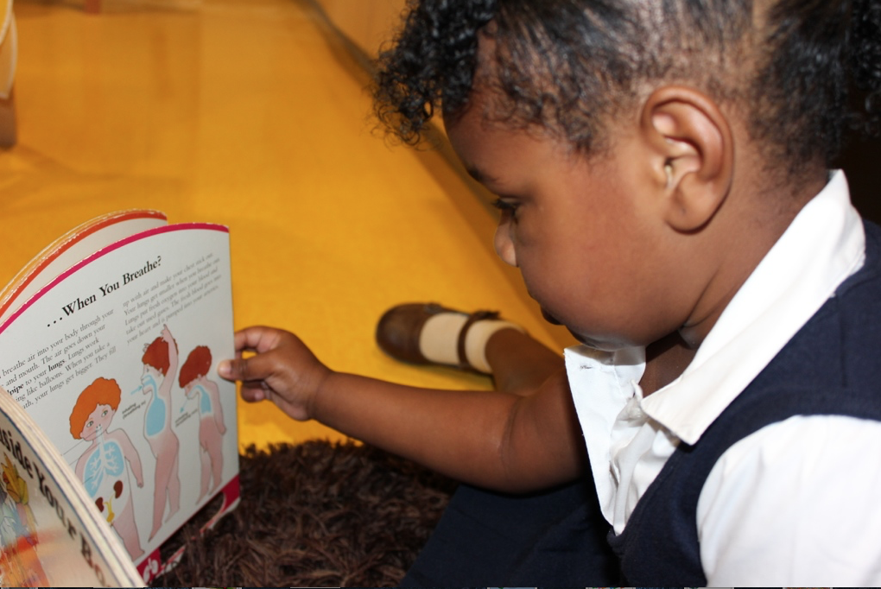
Scholastics book Order
Class Code P64CC

Slide 13
Class Dojo
Stay connected with class Dojo.

Slide 14
http://figueroajrces.weebly.com

Slide 15
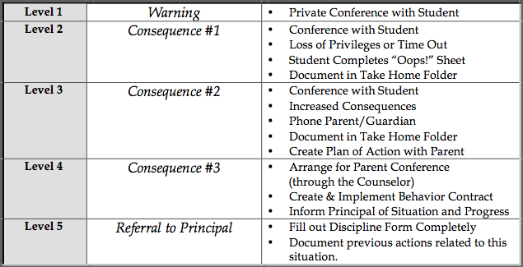
School Wide Discipline Step Plan
Mrs. Melodie Fulmer
Dean of Students
Notes:
Mrs. Fulmer’s role at John Rex is to help guide us in creating a learning environment that is Safe, Respectful, and Responsible which is our Code of Conduct. We discuss with the students how walking on the right side of the stairwell, holding on to the railing is “Being Safe.” We talk about using quiet voices in the cafeteria is being respectful, and we discuss that taking ownership of our behavior is being responsible. With this code of conduct, we practice the procedures that go along with that. We practice walking in the hall, transitioning during specials, lining up for dismissal, and waiting in line in the cafeteria. These procedures, with practice, become routines….and good habits. For students that struggle with these procedures, we put them on a Discipline Step Plan (Teachers, you may insert YOUR step plan here or use this one) to assist them in following procedures. Please notice that parents are not contacted until (give stem level) unless the infraction calls for it. We are trying to instill “self discipline” within our students to help them mature in to self-regulating adults.

Slide 16
Parent Communication & Thursday Folders
Folders will be going home please check them so upcoming school events, parent notes, or homework.
Fill free to write me a note if a change has gone on at home that I need to be aware of. For example, was sick, family death, or late getting to bed.

Slide 17
Math Perspectives Pre-K Curriculum
Emphasis on Developing Number Concepts
Balanced Instructional Settings:
Circle Time & Whole Group
Shared experiences
Exploration Time & Work Stations
Small Group – Guided instruction

Slide 18
Literacy Beginnings:
Create a classroom community that is play-based and prepares children for the literacy-rich world in which they live
Promotes constructive learning through inquiry
Support emerging readers and writers through an array of literacy activities

Slide 19
Pre-K Mathematics Environment
Engages children’s thinking
Prompts questions & investigations
Stimulates curiosity and wonder
Encourages children to look for connections and relationships
Helps children make sense of the mathematics in their world

Slide 20
Pre-K Math Experiences
Number – finding out how many
Spatial – how shapes fit together
Pattern – what comes next
Measurement – making comparisons between objects
Data Collection – sorting and counting

Slide 21
Prekindergarten Development
Cognitive: child’s ability to learn and solve problems
Social & Emotional: child’s ability to interact with others and to appropriately control his/her behavior
Speech & Language: child’s ability to understand and use language
Fine Motor: child’s ability to use small muscles, specifically hands and fingers to manipulate objects
Gross Motor: child’s ability to use large muscles

Slide 22
Responsive Classroom
Conduct “morning meetings” to create a sense of community.
Provide a place where students feel physically and emotionally safe
Develop self discipline skills for working and learning together
Notes:
The Responsive Classroom approach is a way of creating a school climate that enables optimal academic and social growth. This approach ensures positive behavior and productive learning is taking place throughout the school, not just when the students are in my class. Our goal is that all students feel physically and emotionally safe in the school and develop self discipline skills for working and learning together.
We are using this approach to ensure consistent behavior expectations of all students, teaching positive behavior to all students, and establishing school wide procedures for misbehavior.
Thursday folders will be sent home each week with completed student work, various communications from the teacher, the school, and the PTA. Parents are to sign and return the folder to school each Friday.

